Slide 1
Quantitative Equity Trading Signal Based on Financial News Headlines Sentiment Classification
Siyang Huang, Tianjing Cao, Zhuoran Ma
PRESENTED on 10/25/2022
FRE7871 News Analytics and Machine Learning - Project Final Report

Slide 2
Project Goal
Apply NLP techniques to building financial sentiment classification with various fine-tuned supervised machine learning models, then utilize the predicted signals in quant equity trading.
1) 2 Types Headline
Sentiment Label
Sentiment Labels on
Financial Headline
Label Type I :
Next-day Stock
Daily Big Returns
2) 2 Inputs Word-
Embedding NLP Tool
TF-IDF Vectorizer
BERT Transformer
Label Type II :
Pre-trained Pipeline
Sentiment Analysis
3) Cross Validation to
Fine-tune Classifiers
4) Models Validation
Report on Test Set
5) Implement Signal
Backtest and PNL
Text Pre-processing
Data Split by Date
Label Type I and II
as Target Output Y
TF-IDF +
Multinominal Naïve Bayes
BERT +
Random Forest
Evaluate on the
Validation Set
Report on the
Test Set
AUC, Accuracy, ROC
Confusion Matrix
Classification Report
Quant Equity Trade
Strategy with
1-year Horizon
Predicted Positive
Sentiment as
Buying Signal
Predicted Negative
Sentiment as
Selling Signal

Slide 3
Project Motivation
Machine learning (ML) and Natural Language Processing (NLP) have been developing for wide use in many areas. In this project, we applied and compared various ML and NLP techniques through building sentiment classification models on recent financial news headlines data from Kaggle.
We referred to huggingface (2022) transformers pipeline and Sentence Transformer pretrained model (Reimers, 2022) to conduct NLP like text preprocessing, sentiment analysis, and word embedding using both TF-IDF (Term Frequency-Inverse Document Frequency) and BERT (Bidirectional Encoder Representations from Transformers).
Apart from above, we also fine-tuned (Tran, 2020) different ML models, including Naive Bayes and Random Forest, to see how we can efficiently classify the sentiment of financial big data, and transform such sentimental results into quantitative trading signals.

Slide 4
Data Preparation
Financial News Headline Dataset From Kaggle: https://www.kaggle.com/miguelaenlle/massive-stock-news-analysis-db-for-nlpbacktests?select=raw_partner_headlines.csv
Starting Date: 2010-02-03 / Ending Date: 2020-06-04
Train, Validate, Test Set: Split data in date order at about 60%, 13% and 27%
Tag Label For Supervised Machine Learning:
Label Type I – Next day’s daily return of news headline as label, where next day return > 0.1 as positive, or next day return < -0.1 as negative sentiment label.
Label Type II – Pipeline of sentiment analysis with FinBERT which is a pre-trained NLP model in finance domain. Use ‘positive’ and ‘negative’ sentiments & dropped ‘neutral’ labels.

Slide 5
TF-IDF + Naïve Bayes Model
01.

Slide 6
Baseline Model TF-IDF + Multinominal Naïve Bayes
Pre-Processing Steps:
Expanding contractions
Lowercasing headlines
Removing punctuations
Removing digits
Lemmatization
Removing extra whitespaces
TF-IDF Vectorizer:
Consider 1-gram to 3-gram words
Removed stop words in English
Transform headlines into vectors
Data Examples:

Slide 7
Baseline Model TF-IDF + Multinominal Naïve Bayes
Hyperparameter Tuning:
Tune alpha smoothing parameter
Compare AUC score from 5-Fold cross validation on training set
Validation Set Evaluation:
Produce ROC curve and AUC
Calculate accuracy score
Report on Test Set:
Apply the best model
Use confusion matrix and classification report
MNB model is suitable for classification with discrete features, such as TF-IDF vector
Baseline Model 1 & 2 stand for employing TF-IDF Vectorizer and MNB Classifier on Label Type I & II.

Slide 8
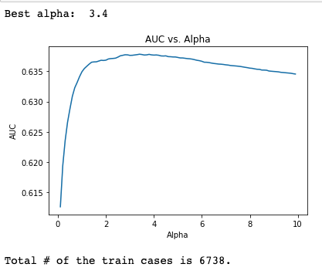
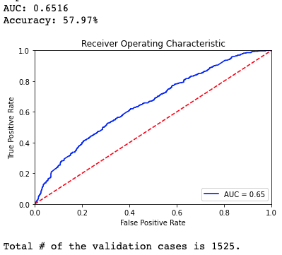
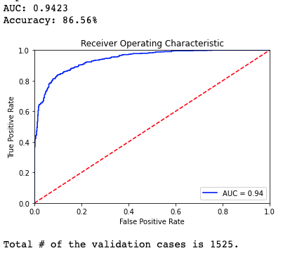
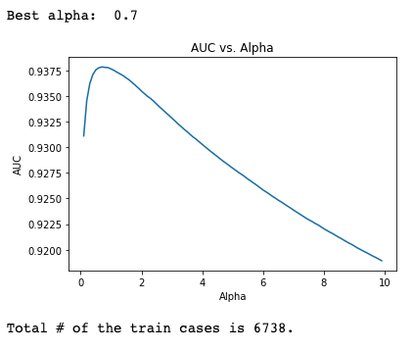
Baseline Model 1
Baseline Model 2
Training Set Best Alpha: 3.4
Validation Set:
Accuracy - 57.97%
AUC - 65.16%
Test Set:
Accuracy - 55.81%
Weight avg f1 - 55.15%
Training Set Best Alpha: 0.7
Validation Set:
Accuracy - 86.56%
AUC - 94.23%
Test Set:
Accuracy - 79.41%
Weight avg f1 - 78.66%

Slide 9
Baseline Model 1
Baseline Model 2
Training Set Best Alpha: 3.4
Validation Set:
Accuracy - 57.97%
AUC - 65.16%
Test Set:
Accuracy - 55.81%
Weight avg f1 - 55.04%
Training Set Best Alpha: 0.7
Validation Set:
Accuracy - 86.56%
AUC - 94.23%
Test Set:
Accuracy - 79.41%
Weight avg f1 - 79.17%

Slide 10
Bert + Random Forest Model
02.

Slide 11
BERT Model BERT Transformer + Random Forest
BERT:
Utilized SentenceTransformer according to SBERT.net with pretrained ‘all-MiniLM-L6-v2’ model to obtain word embedding.
Note: Don’t have to preprocess text here since BERT is pretrained on full text.
Devlin, Chang, Lee and Toutanova (2019) introduced a new language representation model BERT (Bidirectional Encoder Representations from Transformers).
BERT is to pretrain deep bidirectional representations from unlabeled text by jointly conditioning on both left and right contexts in all layers.

Slide 12
BERT Model BERT Transformer + Random Forest
Hyperparameter Tuning:
Tune both n_estimators and max_depth parametes
Compare AUC score from 5-Fold cross validation on training set
Validation Set Evaluation:
Produce ROC curve and AUC
Calculate accuracy score
Report on Test Set:
Apply the best model
Use confusion matrix and classification report
BERT Model 1 and 2 stand for employing BERT Sentence Transformer and Random Forest Classifier on Label Type I and II, respectively.

Slide 13
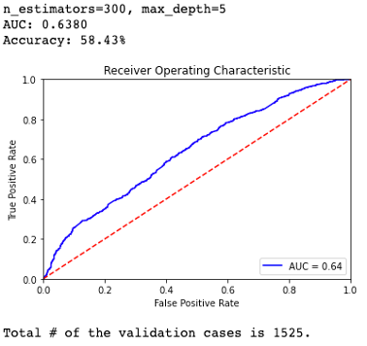
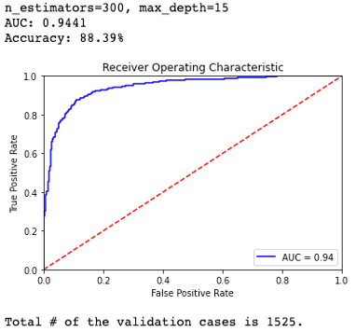
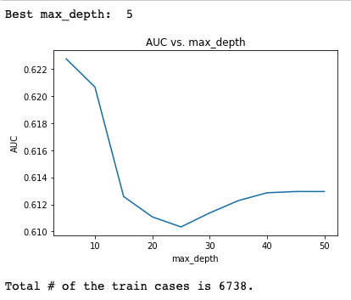
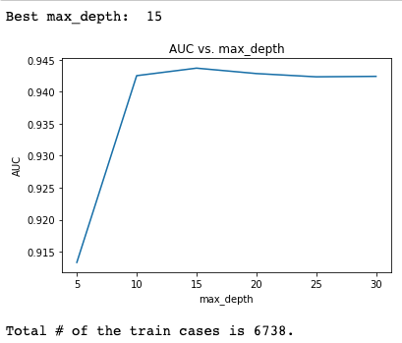
BERT Model 1
BERT Model 2
n_estimators = 300 & max_depth = 5
Validation Set:
Accuracy - 58.43%
AUC - 63.80%
Test Set:
Accuracy - 55.18%
Weight avg f1 - 54.53%
n_estimators = 300 & max_depth = 15
Validation Set:
Accuracy - 88.39%
AUC - 94.41%
Test Set:
Accuracy - 83.41%
Weight avg f1 - 83.41%

Slide 14
BERT Model 1
BERT Model 2
n_estimators = 300 & max_depth = 5
Validation Set:
Accuracy - 58.43%
AUC - 63.80%
Test Set:
Accuracy - 55.18%
Weight avg f1 - 54.53%
n_estimators = 300 & max_depth = 15
Validation Set:
Accuracy - 88.39%
AUC - 94.41%
Test Set:
Accuracy - 83.41%
Weight avg f1 - 83.41%

Slide 15
Baseline Model vs. BERT Model
03.

Slide 16
Baseline Model 1
BERT Model 1
Training Set Best Alpha: 3.4
Validation Set:
Accuracy - 57.97%
AUC - 65.16%
Test Set:
Accuracy - 55.81%
Weight avg f1 - 55.04%
n_estimators = 300 & max_depth = 5
Validation Set:
Accuracy - 58.43%
AUC - 63.80%
Test Set:
Accuracy - 55.18%
Weight avg f1 - 54.53%

Slide 17
Baseline Model 2
BERT Model 2
Training Set Best Alpha: 0.7
Validation Set:
Accuracy - 86.56%
AUC - 94.23%
Test Set:
Accuracy - 79.41%
Weight avg f1 - 79.17%
n_estimators = 300 & max_depth = 15
Validation Set:
Accuracy - 88.39%
AUC - 94.41%
Test Set:
Accuracy - 83.41%
Weight avg f1 - 83.41%

Slide 18
More Models on Label Type II
04.

Slide 19
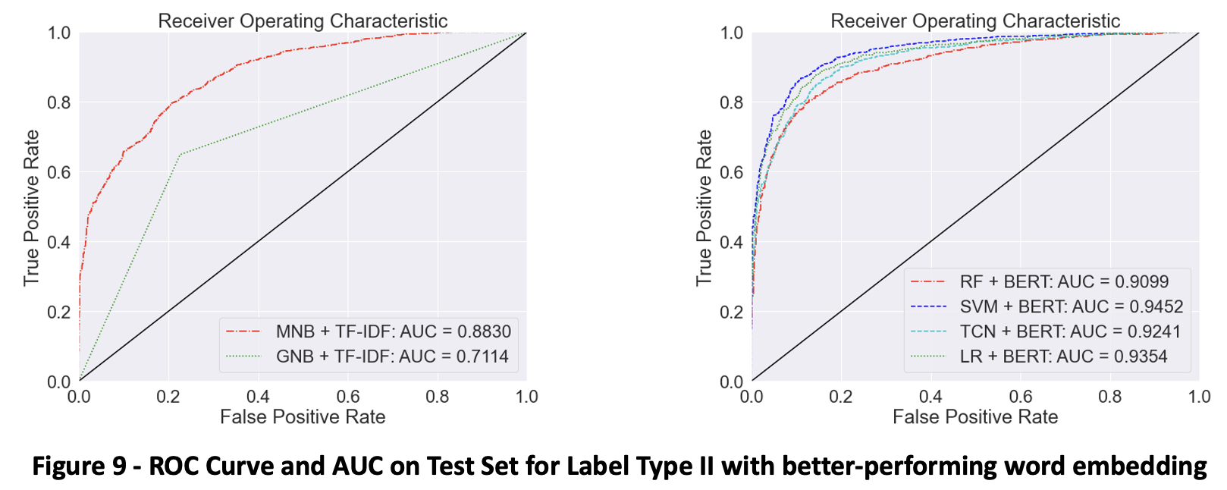
Gaussian NB / RF / Logistic / SVM / TCN
Gaussian Naive Bayes
Logistic Regression: solver = ‘lbfgs’
SVM: kernel=‘rbf’ & C=1
TCN:
Sigmoid activation
Dropout layer with a rate of 0.5 to resolve overfitting
‘binary_crossentropy’ loss function
‘adam’ optimizer

Slide 20
Gaussian NB / RF / Logistic / SVM / TCN
Simple Naive Bayes models ➔ more effective with TF-IDF
Pretrained BERT transformer ➔better with complex models like Logistic, RF, SVM and TCN
AUC in evaluating imbalance targets ➔ similar results except for GNB
SVM with BERT transformer reaches the highest for both AUC of 94.52% and accuracy of 87.72%

Slide 21
Test Examples
TF-IDF + Logistic Regression: 7 out of 10
BERT + SVM Classifier: 9 out of 10
Summary:
Impractical to use stock return as a sentiment label of financial news headlines (Label Type I).
More reliable label marking techniques or manual tagging could be researched and implemented.
Above models could be further fine-tuned to enhance performance.

Slide 22
Quantitative Equity Trading Signal
05.

Slide 23
Voting for stock signal each day:
Add up headline signals for each stock today as “Signal_Sum” for next day
Signal_0: Buy stock with news
Signal_1 : Long Positive “Signal_Sum”
Signal_2: Short Negative “Signal_Sum”
Calculate stock weight in portfolio:
Equally weighted means to buy or sell at the same weight on the same day
Signal weighted assumes more news indicates stronger sentiment, so stocks are weighted on “Signal_Sum”
Sum of weights in one day = 100%
Trading Strategy Portfolio with Discrete Signal
Implemented a systematic equity trading strategy on test set headlines trained on Label Type II
Stocks with the one-year investment horizon from 2019-06-02 to 2020-06-02
Predicted positive sentiment label as buying stock signal (+1), and negative as selling stock signal (-1)
Notes:
All three strategies used today’s sentiment label as tomorrow’s trading signal and cleared position on a daily basis, and each day, we trade only the stocks with news meaning the signals are discrete.

Slide 24
Calculate strategy portfolio return:
Weighted average return of individual stocks that had news in one day
Plotted the cumulative return, obtained annualized return, Sharpe ratio and MDD to evaluate performance
In the followings, we implemented BERT + Random Forest and BERT + SVM models that have relatively higher test accuracy to predict news sentiment and backtest quantitative equity trading signals.
Trading Strategy Portfolio with Discrete Signal
Implemented a systematic equity trading strategy on test set headlines trained on Label Type II
Stocks with the one-year investment horizon from 2019-06-02 to 2020-06-02
Predicted positive sentiment label as buying stock signal (+1), and negative as selling stock signal (-1)
Notes:
All three strategies used today’s sentiment label as tomorrow’s trading signal and cleared position on a daily basis, and each day, we trade only the stocks with news meaning the signals are discrete.

Slide 25
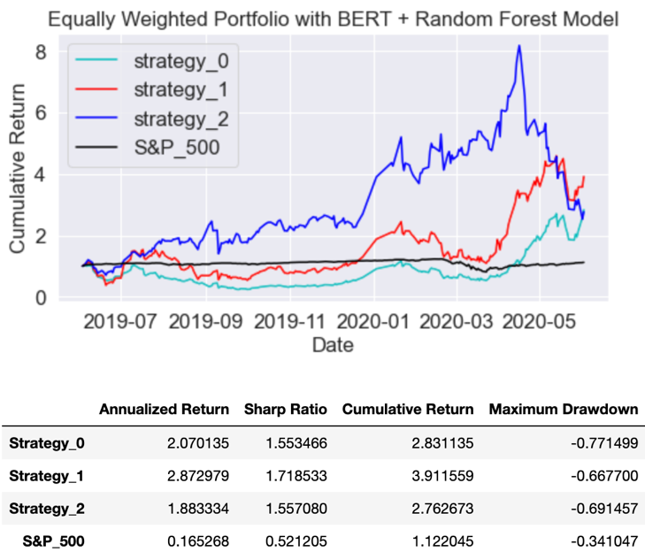
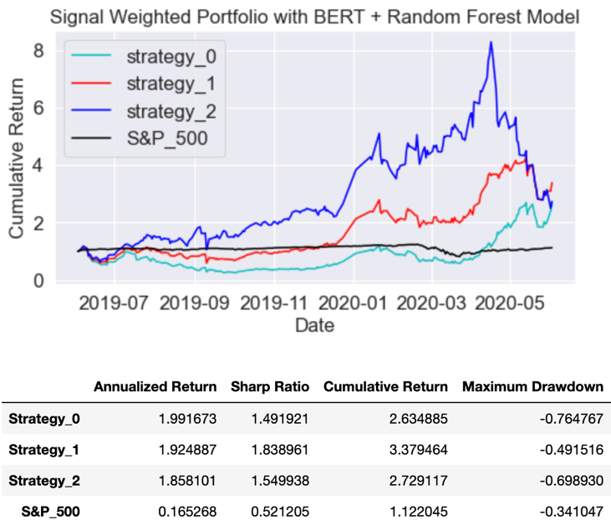
Equally Weighted Portfolios with BERT + RF Model
Signal Weighted Portfolios with BERT + RF Model
Equally weighted portfolios perform better overall than signal weighted ones.
Strategy_1 is the best-performing strategy with Sharpe at about 1.7 and a cumulative return over 3.
Shorting selling Strategy_2 is slightly weaker than Strategy_0, and all three strategies beat S&P 500.

Slide 26
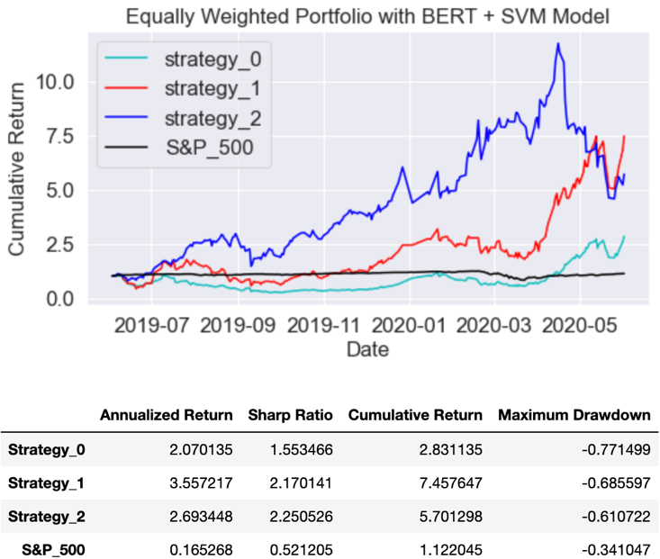
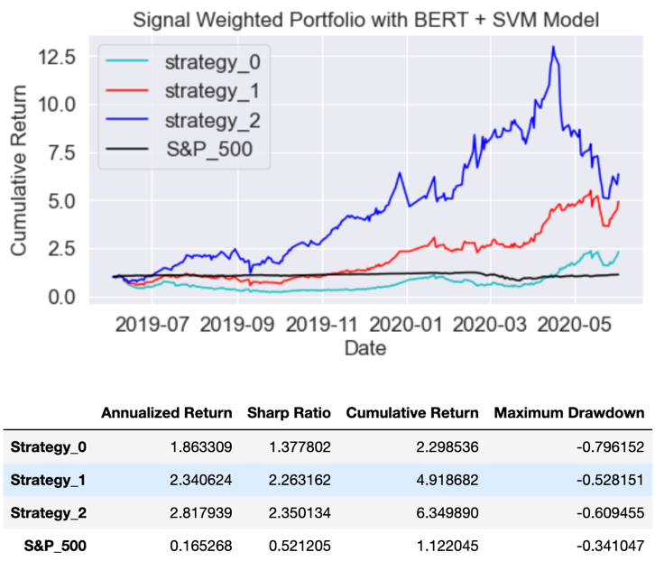
Equally Weighted Portfolios with BERT + SVM Model
Signal Weighted Portfolios with BERT + SVM Model
Strategy_1 outperforms when equally weighted, while short selling Strategy_2 becomes the best signal weighted one with Sharpe over 2.3 and cumulative return over 6.
Strategy_1 and Strategy_2 both surpass baseline Strategy_0 more significantly with SVM classifier.

Slide 27
Equally Weighted Portfolios with BERT + SVM Model
Signal Weighted Portfolios with BERT + SVM Model
In conclusion, Strategy_1 is more stable and BERT + SVM model could improve strategy performance.
Strategy_2 had been the best-performing strategy once, reaching a cumulative return of over 10. However, the dramatic fall in 2020 (incorrectly shorted growing stocks) led to irreparable losses.

Slide 28
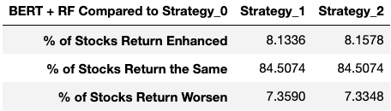
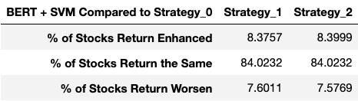
Continuous Stock Tracking
Built on above discrete signals, we tried the continuous tracking on individual stock level to evaluate model performances statistically.
Strategy_0: buy and hold one share of stock for the whole one-year period. (Baseline)
Strategy_1: close long position on negative Signal_1
Strategy_2: sell one stock on negative Signal_2
BERT + RF Model: ~8.14% of the 1-year cumulative returns are enhanced by Strategy_1 and Strategy_2, compared to Strategy_0 baseline.
Most stocks (~84.5%) remained the same, while nearly 7.34% became worse than buy and hold.
Correctly detect some dropping stock prices but also wrongly miss or make losses on rising stocks.
% Results Out of 4131 Stocks

Slide 29
Continuous Stock Tracking
Built on above discrete signals, we tried the continuous tracking on individual stock level to evaluate model performances statistically.
Strategy_0: buy and hold one share of stock for the whole one-year period. (Baseline)
Strategy_1: close long position on negative Signal_1
Strategy_2: sell one stock on negative Signal_2
BERT + SVM Model: Both % of stocks improved and deteriorated increased by over 0.2%, while % of stock unchanged decreased by 0.5%.
Enhancement brought by Strategy_1 and 2 is more significant than downside caused by wrongly predicted signals.
Critical to further reduce the error.
% Results Out of 4131 Stocks

Slide 30
Future Improvement
See if imbalanced target label affect the accuracy of classification model
Include “neutral” sentiment and have 3 classes of labels to buy, hold, and sell stocks
Try next n-day return instead of next 1-day return as label, and distinguish between long-term effect and short-term effect of news
Adjust models to further decrease the probability of wrongly predicted sentiment label, as well as the incorrect stock trading signals
Develop more reasonable or complicated strategy portfolios for investing

Slide 31
Reference
[1] Araci, D. (2019). Finbert: Financial sentiment analysis with pre-trained language models. arXiv preprint arXiv:1908.10063.
[2] Agrawal, R. (2021). Must Known Techniques for text preprocessing in NLP. Retrieved 28 September 2022, from https://www.analyticsvidhya.com/blog/2021/06/must-known-techniques-for-text-preprocessing-in-nlp/
[3] Kaggle (2020). Daily Financial News for 6000+ Stocks. Retrieved 28 September 2022, from https://www.kaggle.com/datasets/miguelaenlle/massive-stock-news-analysis-db-for-nlpbacktests?resource=download&select=raw_partner_headlines.csv
[4] Devlin, J., Chang, M. W., Lee, K., & Toutanova, K. (2018). Bert: Pre-training of deep bidirectional transformers for language understanding. arXiv preprint arXiv:1810.04805.
[5] Huggingface. (2022). Pipelines . Retrieved 28 September 2022, from https://huggingface.co/docs/transformers/main_classes/pipelines
[6] Reimers, N. (2022). Quickstart — Sentence-Transformers documentation. Retrieved 28 September 2022, from https://www.sbert.net/docs/quickstart.html
[7] Tran, C. (2020). Tutorial: Fine-tuning BERT for Sentiment Analysis - by Skim AI. Retrieved 28 September 2022, from https://skimai.com/fine-tuning-bert-for-sentiment-analysis/

Slide 32
Welcome for Q&A Thank you for listening!

